Slide 1

QUANTUM ERROR CORRECTION
HR Jeevitha
CDAC-Bangalore

Slide 2
Outline :
Classical Error Correction
Quantum Error Correction
Bit Flip Error
Phase Flip Error
Shor's Code

Slide 3
Outline :
Classical Error Correction
Quantum Error Correction
Bit Flip Error
Phase Flip Error
Shor's Code

Slide 4
Why do we need Error Correction?
Data stored or transmitted is affected by noise and interference.
A single bit can flip during transmission:
0 → 1 or 1 → 0.
Even one wrong bit can change the meaning of the entire message.
Goal: Detect and correct errors to ensure reliable communication.
Eg: 101 → 100 (bit flip)
“Can we fix this?”
The 3-bit repetition code.

Slide 5
The 3-bit Repetition Code
Encoding : In this 0 is encoded as 000 and 1 as 111.
Single-bit errors leads to distinct 3-bit strings:
000 -> 001/010/100 ; 111 -> 110/101/011
Here 000 and 111 are called the codewords.
Error detection : The decoder determines whether the noisy string represents 000 or 111 using parity checks (majority voting).
The 3-bit code can correct up to one bit error.
Assumption of the noise is taken as iid (independent, identically, distributed)

Slide 6
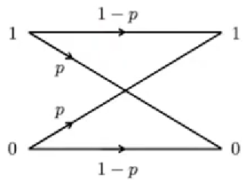
Noise on Classical bits
Bit flip errors: The binary symmetric channel
p is the probability of single bit flip.
Possible outcomes for 3 bits:
No error (probability (1−p)³)
One error (probability 3p(1−p)²)
Two errors (probability 3p²(1−p))
Three errors (probability p³)

Slide 7
Reliability of 3-Bit Repetition Code
Success Probability P_{success} :
No error = probability = (1−p)³
Exactly One error = probability = 3p(1−p)²
P_{success} ​= (1−p)³ + 3p(1−p)²
Suppose p = 0.1 (10%)
Without 3-bit code : error probability p = 0.1
With 3-bit code : error probability P_{fail} = 0.028
Error probability dropped from 10% → 2.8%.
Failure Probability P_{fail} :
Two errors = probability = p²(1−p)
Three errors = probability = p³
P_{fail} = 3p²(1−p) + p³
“Now that we’ve seen how repetition helps in classical systems, let’s explore how similar ideas extend to quantum error correction.”

Slide 8
Outline :
Classical Error Correction
Quantum Error Correction
Bit Flip Error
Phase Flip Error
Shor's Code

Slide 9
Quantum Error Correction
Quantum error correction (QEC) is a crucial field in quantum computing aimed at protecting quantum information from errors caused by various types of noise, such as bit-flips and phase-flips.
A bit-flip(X error) occurs when the state of a qubit changes from ∣0⟩ to ∣1⟩ or vice versa, which is analogous to flipping a classical bit.
A phase-flip error (Z error) flips the relative phase between the qubit states |+⟩ and |-⟩, effectively flipping the sign of the |1⟩ component only in the computational basis i.e. the state ∣0⟩ remains unaffected by this error.

Slide 10
Outline :
Classical Error Correction
Quantum Error Correction
Bit Flip Error
Phase Flip Error
Shor's Code

Slide 11
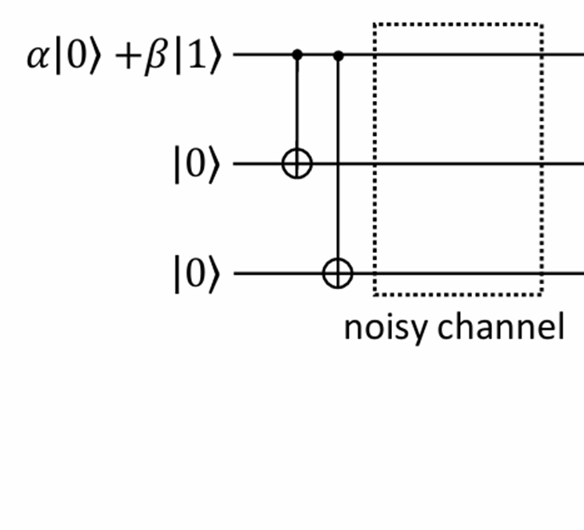
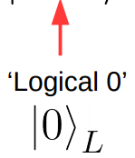
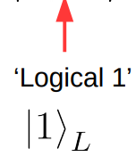
Bit Flip
Encoding:
Encoding is the process of transforming a single logical qubit into a larger entangled state across multiple physical qubits, in order to protect the information against errors. The goal is to add redundancy without losing the quantum nature of the state.
This process encodes a logical qubit’s information into three physical qubits using CNOT gates.
α|0⟩ + β|1⟩ → α∣000⟩ + β∣111⟩
It ensures that if a bit error occurs on any one of the qubits, the majority value among the three still reflects the correct logical state.

Slide 12
Bit Flip
Error Simulation : After encoding the logical qubit into three physical qubits, we simulate the presence of an error to model the effects of noise in a quantum system. To simulate an error, a bit-flip (X gate) is manually applied to one of the 3 qubits, mimicking the effect of noise in a real system.
An example is causing a X error on the first qubit leads the state of the logical qubit as:
X₀∣ψ_{L}⟩= α|100⟩ + β|011⟩

Slide 13
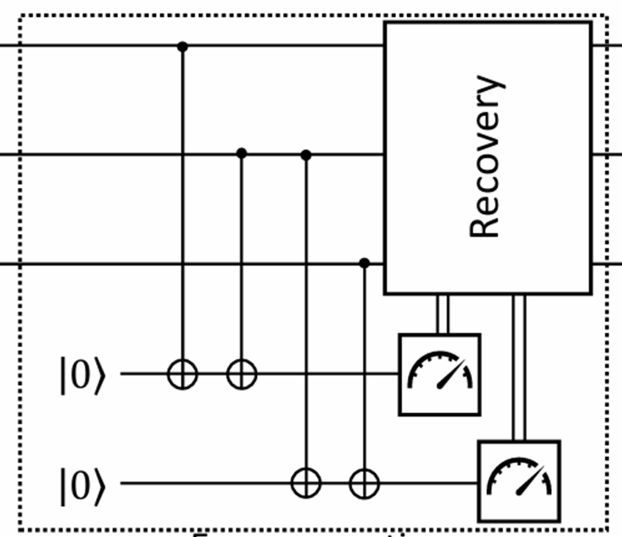
Bit Flip
Error detection(Syndrome measurement):
After an error is introduced in the encoded quantum state, the next step is to detect and identify which qubit, if any, has been affected. This is done through a process called syndrome measurement, which compares qubits using ancillary measurements without directly measuring the data qubits themselves. This allows the error to be located without collapsing the encoded quantum state.
The syndrome values indicate which of the three data qubits (if any) has flipped:
00 → No error
01 → Error on qubit 3
10 → Error on qubit 1
11 → Error on qubit 2
This process lets us detect the position of a single bit-flip error without collapsing the encoded quantum information, so that a targeted correction (applying an X gate) can restore the correct logical state.

Slide 14
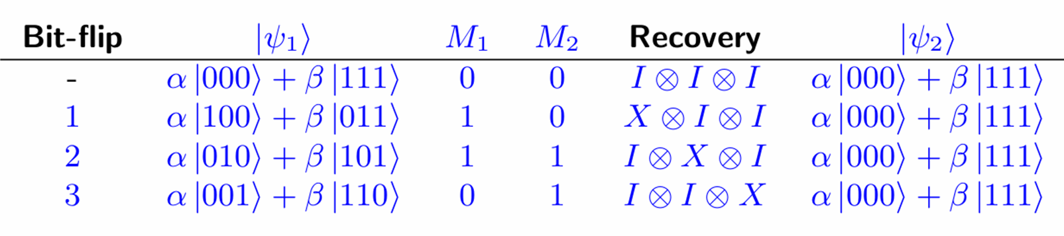
Bit Flip Syndrome Table
According to the syndrome measurement apply X gate to that particular qubit and the logical qubit will be error-free.

Slide 15
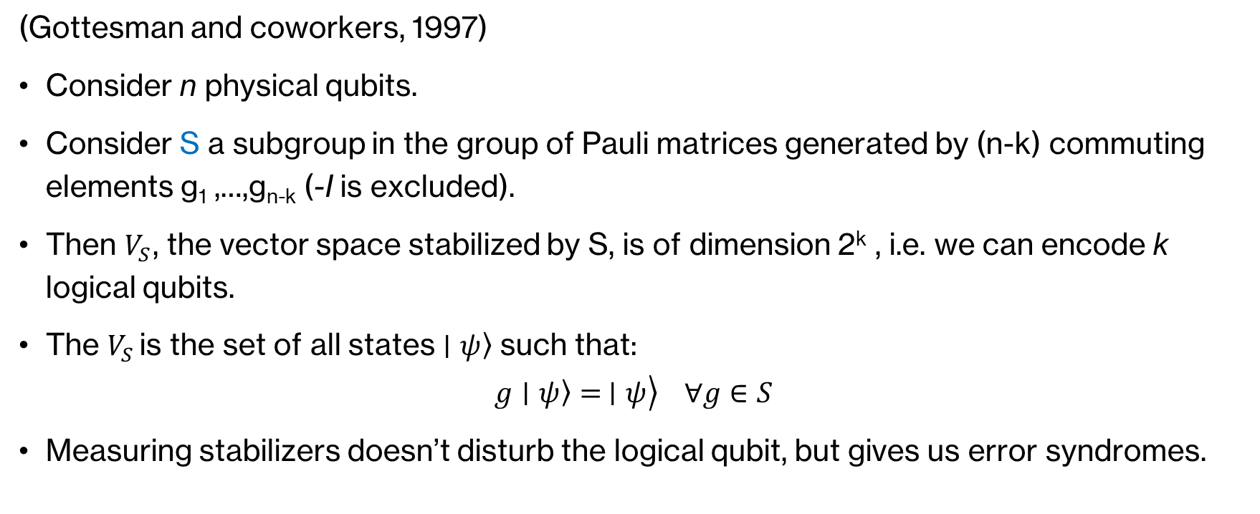
Stabilizer code [n, k]
(Gottesman and coworkers, 1997)
Consider n physical qubits.
Consider S a subgroup in the group of Pauli matrices generated by (n-k) commuting elements g₁ ,…,g_{n-k} (-I is excluded).
Then $V_{S}$, the vector space stabilized by S, is of dimension 2^{k} , i.e. we can encode k logical qubits.
The $V_{S }$is the set of all states $\left.∣ψ\right\rangle$ such that:
$$\left.\left.g∣ψ\right\rangle = ∣ψ\right\rangle ∀g∈S$$
Measuring stabilizers doesn’t disturb the logical qubit, but gives us error syndromes.

Slide 16
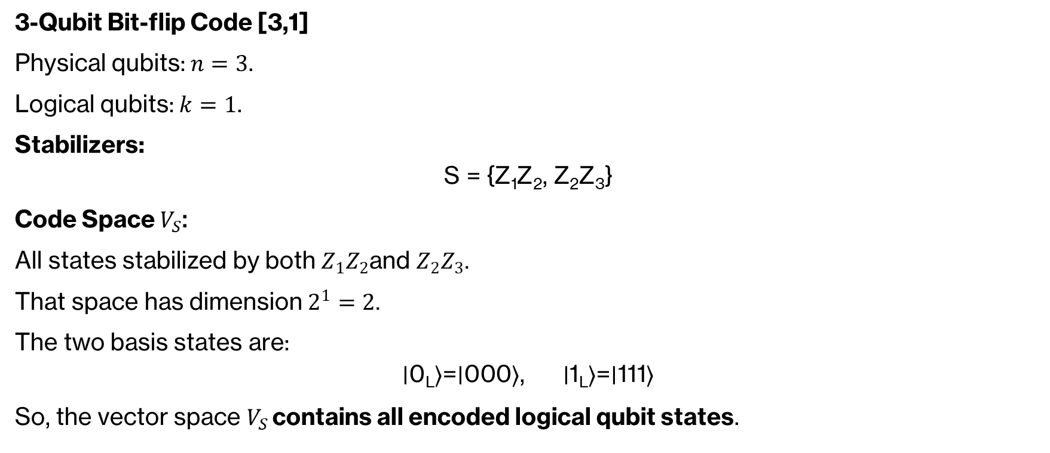
Example:
3-Qubit Bit-flip Code [3,1]
Physical qubits: $n=3$.
Logical qubits: $k=1$.
Stabilizers:
$$\text{S} \text{=} \text{\{}\text{Z}\text{1}\text{​}\text{Z}\text{2}\text{​}\text{,} \text{Z}\text{2}\text{​}\text{Z}\text{3}\text{​}\text{\}}$$
Code Space $V_{S}$:
All states stabilized by both $Z_{1}Z_{2}$and $Z_{2}Z_{3}$.
That space has dimension $2^{1}=2$.
The two basis states are:
$$\text{∣}\text{0}\text{L}\text{​}\text{⟩}\text{=}\text{∣}\text{000}\text{⟩}\text{, }\text{∣}\text{1}\text{L}\text{​}\text{⟩}\text{=}\text{∣}\text{111}\text{⟩}$$
So, the vector space $V_{S }$contains all encoded logical qubit states.

Slide 17
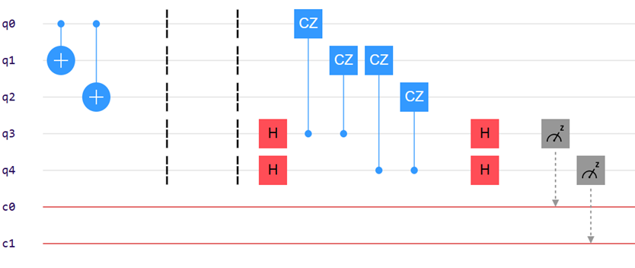

Stabilizers for Bit Flip
Z⊗Z⊗I
I⊗Z⊗Z
So, here Z⊗Z checks the parity between two qubits.
Syndrome = 11
I ⊗ X ⊗ I
Z ⊗ Z ⊗ I

Slide 18
Outline :
Classical Error Correction
Quantum Error Correction
Bit Flip Error
Phase Flip Error
Shor's Code

Slide 19
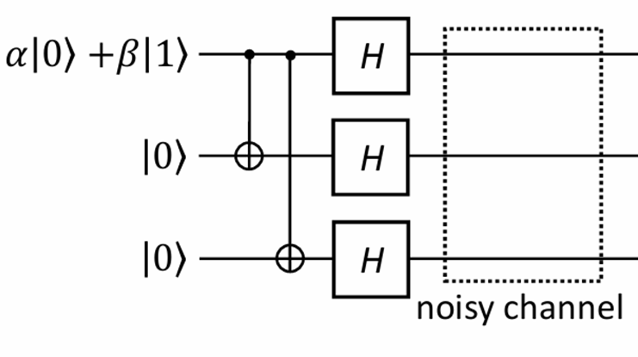

Phase Flip
Encoding :
Similar to the encoding process for bit-flip error correction, the phase-flip code protects a logical qubit from phase errors by distributing its information across three physical qubits.
The encoding begins by applying CNOT gates from the logical qubit to two ancilla qubits, creating entanglement in the computational basis. Then, Hadamard gates are applied to all three qubits to transform the state into the Z-basis.
In this encoded form, the logical qubit’s information is spread across a superposition of basis states. If a phase-flip error (Z) occurs on any one of the physical qubits, it can be detected and corrected by using majority voting.

Slide 20
Phase Flip
Error Simulation : Similar to the bit-flip error simulation, after encoding the logical qubit into three physical qubits, we simulate the effect of noise in a quantum system by introducing a controlled error. To simulate a phase-flip error, a Z gate is manually applied to one of the three qubits. This models dephasing noise, which alters the phase of the quantum state without flipping the bit.
For example, applying a Z gate to the first qubit of the encoded state transforms the logical qubit as:
Z₀∣ψ_{L}⟩ = α∣− + +⟩ + β∣+ − −⟩

Slide 21
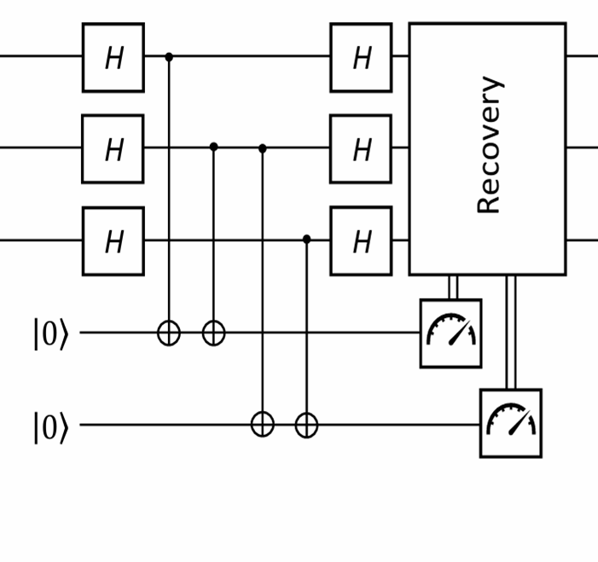
Phase Flip
Error detection(Syndrome measurement):
Since Z errors are not directly observable in the computational basis, we apply Hadamard gates (H) to all three data qubits before the syndrome measurement.
The syndrome values remain the same:
00 → No error
01 → Error on qubit 3
10 → Error on qubit 1
11 → Error on qubit 2
Once the error location is identified, Hadamard gates are applied again to return to the Z-basis, and then a Z gate is applied to the affected qubit to reverse the phase-flip and recover the correct logical state.

Slide 22
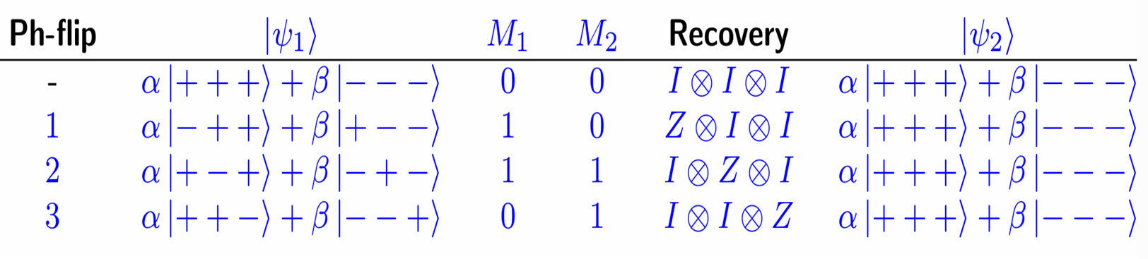
Phase Flip Syndrome Table
According to the syndrome measurement apply Z gate to that particular qubit and the logical qubit will be error-free.

Slide 23
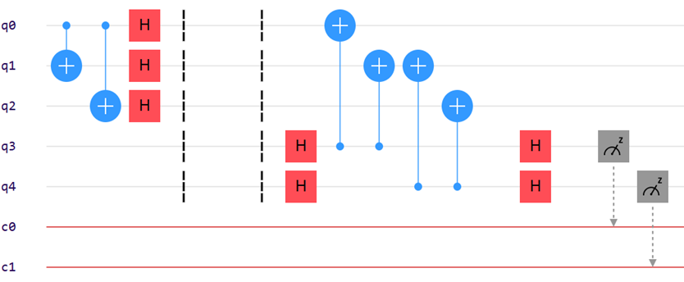

Stabilizers for Phase Flip
X⊗X⊗I
I⊗X⊗X
So, here X⊗X checks the parity between two qubits
Syndrome = 10
Z ⊗ I ⊗ I
X ⊗ X ⊗ I
Syndrome = 10​
​
Z ⊗ I ⊗ I​
I ⊗ X ⊗ X​
​
Commute

Slide 24
Outline :
Classical Error Correction
Quantum Error Correction
Bit Flip Error
Phase Flip Error
Shor's Code

Slide 25
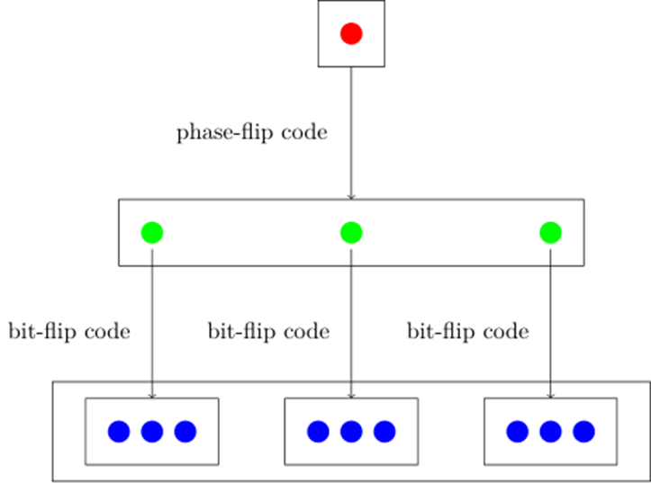
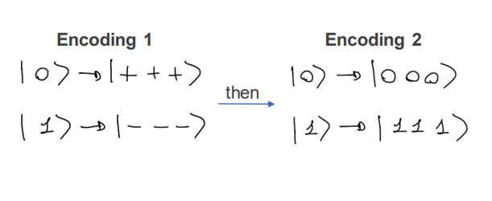
Shor's Code [[9,1,3]]

Slide 26
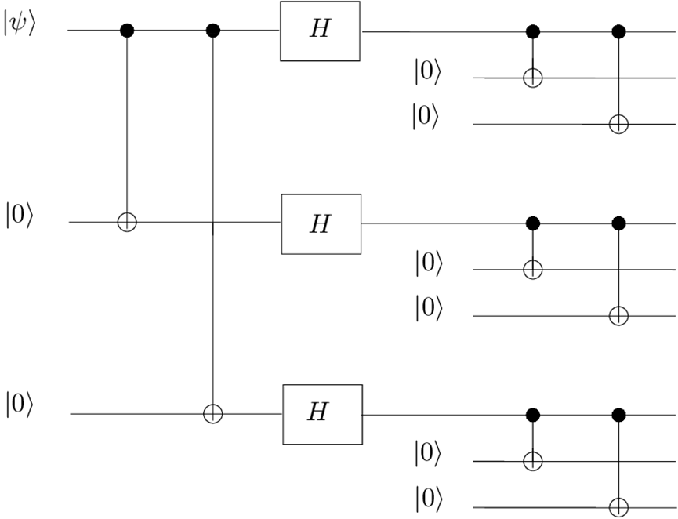
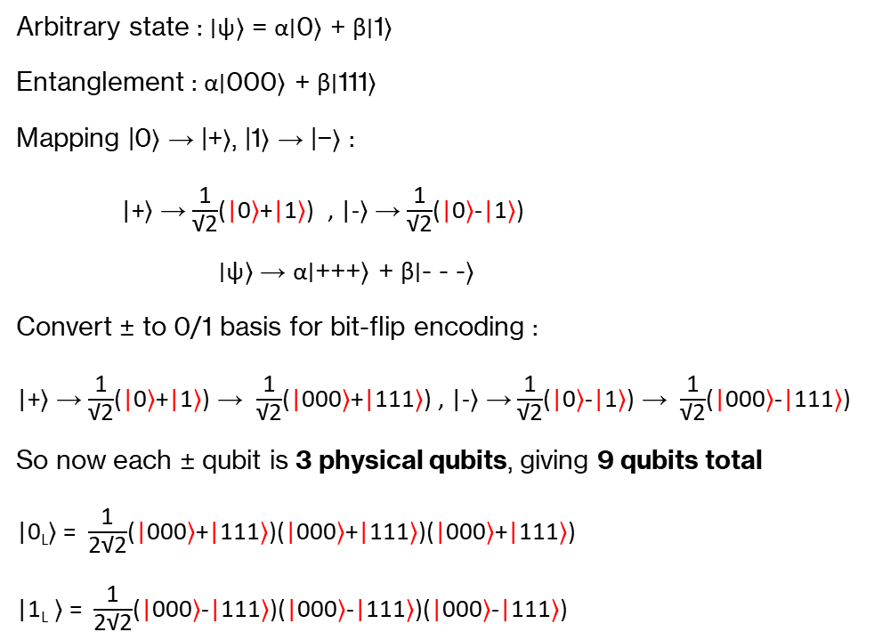
Encoding
Arbitrary state : ∣ψ⟩ = α∣0⟩ + β∣1⟩
Entanglement : α∣000⟩ + β∣111⟩
Mapping |0⟩ → |+⟩, |1⟩ → |−⟩ :
|+⟩ → $\frac{\text{1}}{\text{√}\text{2}}$(|0⟩+|1⟩) , |-⟩ → $\frac{\text{1}}{\text{√}\text{2}}$(|0⟩-|1⟩)
∣ψ⟩ → α∣+++⟩ + β∣- - -⟩
Convert ± to 0/1 basis for bit-flip encoding :
|+⟩ → $\frac{\text{1}}{\text{√}\text{2}}$(|0⟩+|1⟩) → $\frac{\text{1}}{\text{√}\text{2}}$(|000⟩+|111⟩) , |-⟩ → $\frac{\text{1}}{\text{√}\text{2}}$(|0⟩-|1⟩) → $\frac{\text{1}}{\text{√}\text{2}}$(|000⟩-|111⟩)
So now each ± qubit is 3 physical qubits, giving 9 qubits total
|0_{L}⟩ = $\frac{\text{1}}{\text{2}\text{√}\text{2}}$(|000⟩+|111⟩)(|000⟩+|111⟩)(|000⟩+|111⟩)
|1_{L} ⟩ = $\frac{\text{1}}{\text{2}\text{√}\text{2}}$(|000⟩-|111⟩)(|000⟩-|111⟩)(|000⟩-|111⟩)

Slide 27
Stabilizers for Shor's Code
Z₁Z₂, Z₂Z₃
Z₄Z₅, Z₅Z₆
Z₇Z₈, Z₈Z₉
X₁X₂X₃X₄X₅X₆
X₄X₅X₆X₇X₈X₉

Slide 28
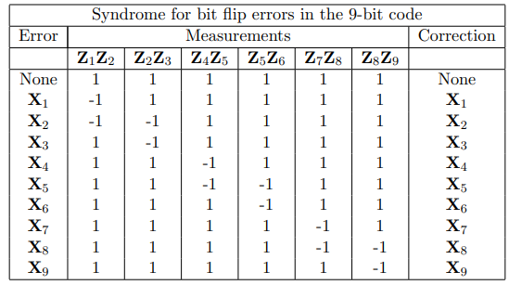
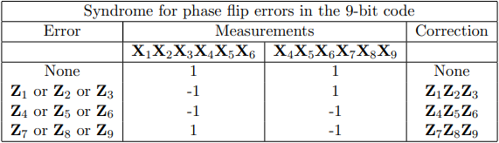
Syndrome Table

Slide 29
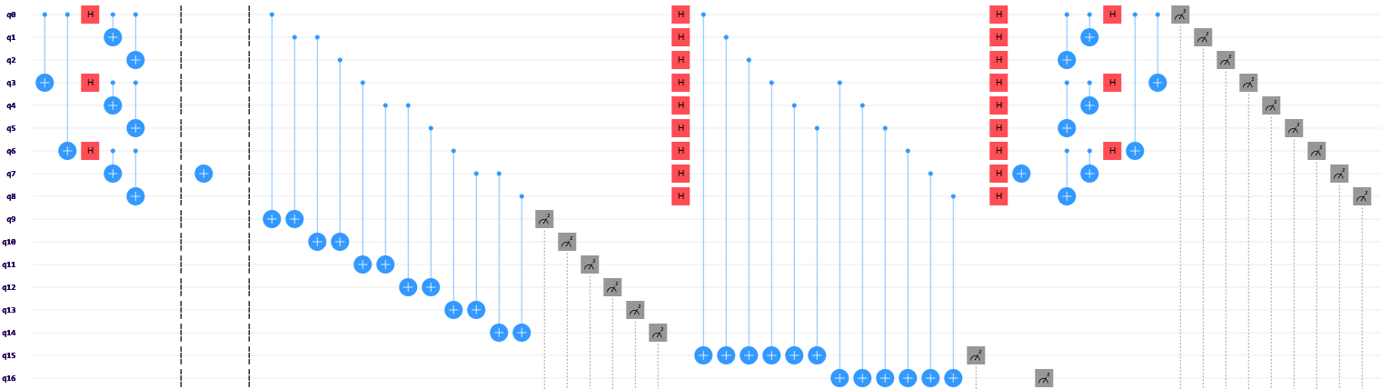
Circuit for Shor's Code

Slide 30
Thank you

